Slide 1
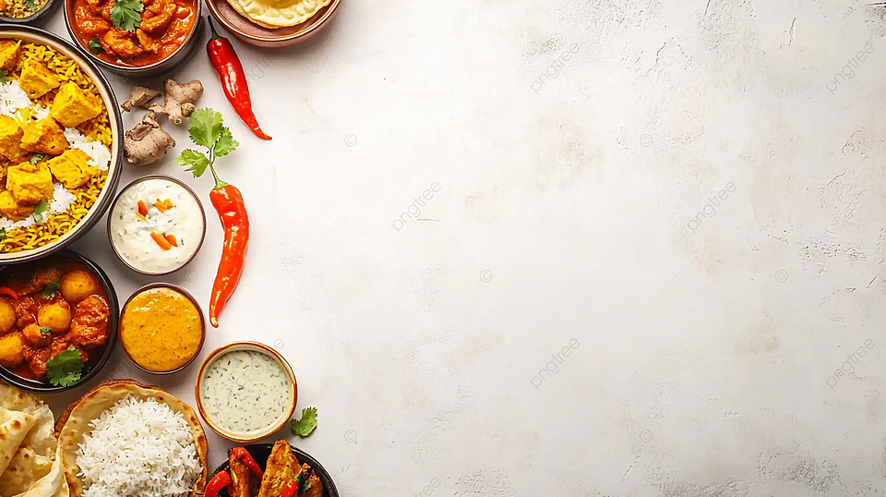
“TASTERS OF INDIA” TEAM NAME: “YUM”
CIEL Kingston VibeAlthon 2025

Slide 2

PROBLEM RECAP & OBJECTIVE:
• Validated Problem Statement:
Traditional Indian foods and their cultural stories are disappearing in the modern world. People, especially the younger generation, are unaware of their regional food heritage.
• Key User Main Point:
Users struggle to find authentic traditional recipes and their true origins in one reliable platform.
• Objective of the Prototype:
To create an interactive app — Tasters of India — that showcases traditional dishes from every Indian state with recipes, stories, and maps.
• Expected Outcomes / Success Matrics:
Users discover and learn about India’s heritage foods.
More engagement and awareness of local cuisines.
Increased appreciation and preservation of regional food culture.

Slide 3
PROTOTYPE OVERVIEW:
• Description:
Tasters of India is an interactive mobile app that showcases traditional dishes from every Indian state.
It includes recipes, origins, cultural stories, and a map showing where each dish is most popular.
Users can rate dishes, comment, and even add how they made them.
• Technology Stack / Tools Used:
Design: Figma / Canva (for UI & prototype design)
Frontend (planned): React Native
Backend (planned): Firebase / Node.js
Database: Firestore / MongoDB
Map Integration: Google Maps API
• Prototype Type:
Currently clickable and conceptual — demonstrates all main features and app flow.
• Visuals / Screenshots:
Include images of:
Login & Sign-Up Page
Home Screen with Food Map
Dish Details Page (recipe + story)
Rating & Comment Screen

Slide 4
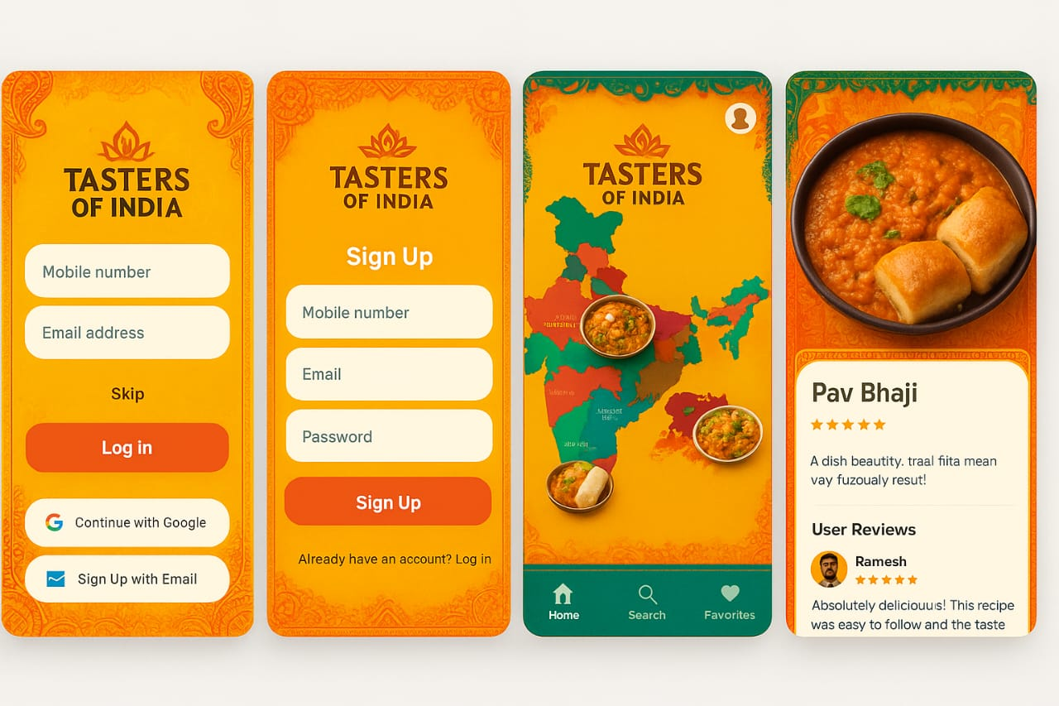

Slide 5
USER INTERFACE & EXPERIENCE:
User Journey (Visual Flow)
Open App → Sign Up / Log In → Browse Dishes → Explore Recipe & Location → Rate & Comment → Unlock More Recipes
(Use arrows or a simple flow diagram)
2️⃣ Key Features / Interactions
Interactive India map with dish highlights
Swipe gestures: Left = Exit | Right = Home
Profile customization & ratings/comments
Real-time updates for recipes
3️⃣ Unique & Innovative
Combines heritage food + location discovery
Vintage UI reflecting culture
Promotes regional, lesser-known cuisines
Builds community interaction
4️⃣ Next Steps / Scaling
Add more dishes & states → full India coverage
Introduce AR/VR tutorials
Partner with restaurants & food festivals
Add AI-based recipe recommendations

Slide 6
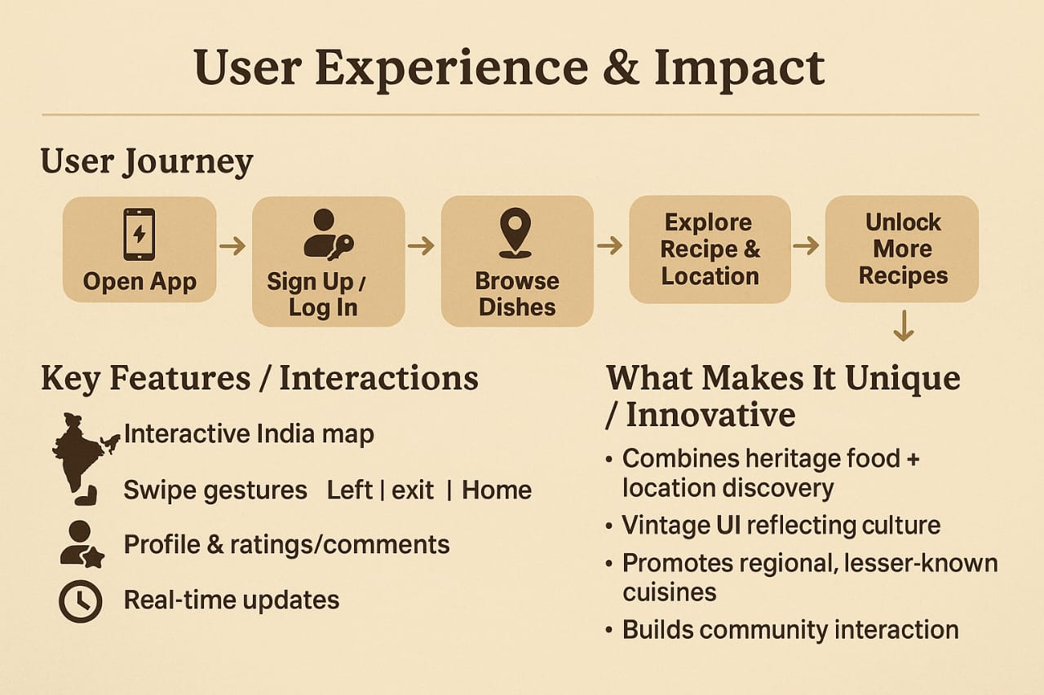

Slide 7
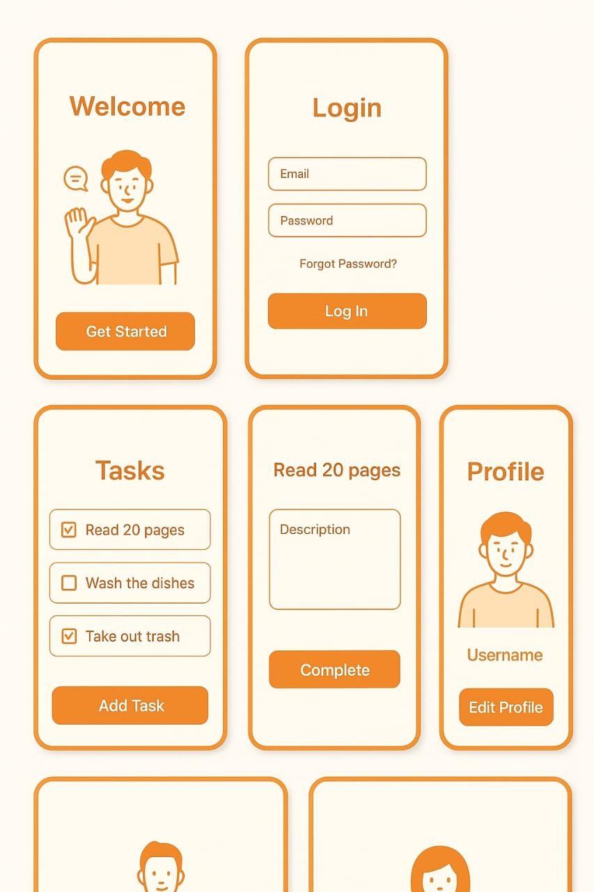

Slide 8
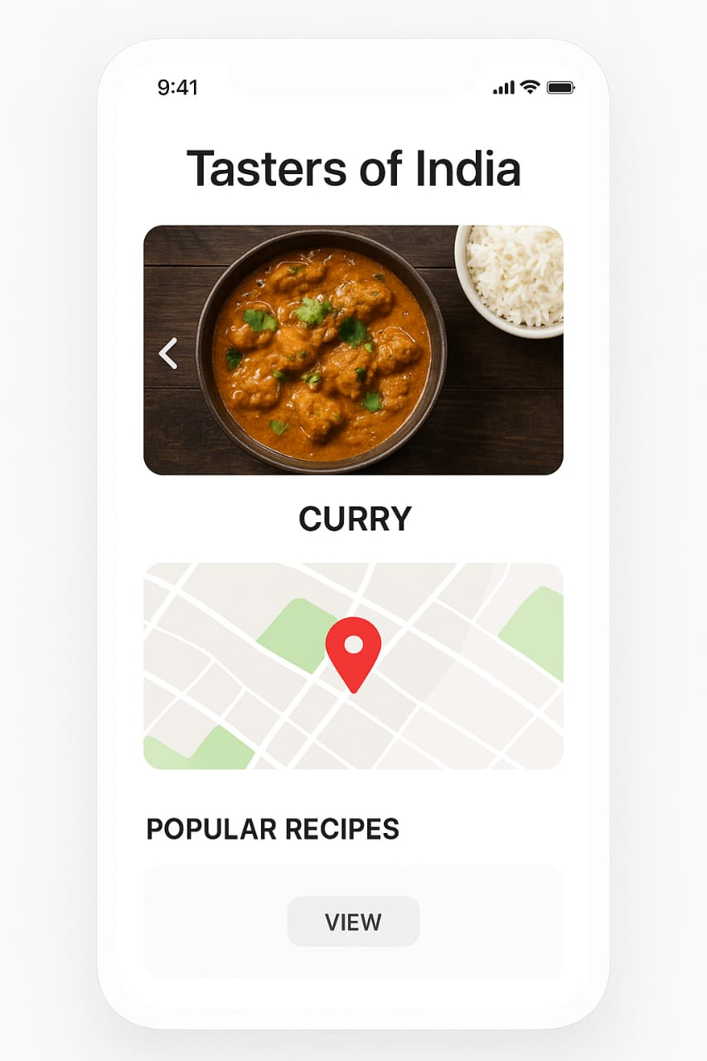

Slide 9


